Slide 1

True Value Car Analysis
P. Manikanta
M. Vaibhav Kiran Reddy

Slide 2
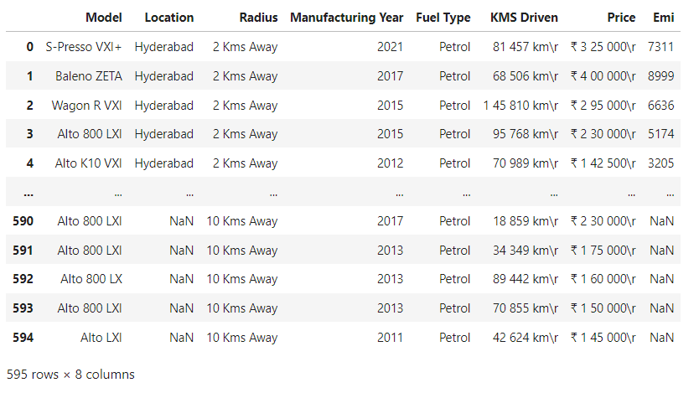

Orginal True Value Car Dataset

Slide 3
Exploratory Data Analysis:
Data Cleaning Steps
1. Loaded the dataset using Pandas (595 rows × 8 columns).
2. Checked dataset structure using info(), head(), and dtypes.
3. Identified missing and inconsistent data using isnull().sum().
4. Removed spaces extra characters from Kms Driven and Price
5. Replaced missing values using mode (categorical) and mean (numerical).
6. Rechecked dataset to ensure all missing values were handled.
7. Prepared cleaned dataset for Data Manipulation.

Slide 4
2.Data Manipulation Steps
1. Data Cleaning:
  Removed unwanted characters, symbols, and spaces from columns like KMS Driven and Price for consistency.
2. Handling Missing Values:
  Filled missing Location values using forward fill and replaced missing Emi values with the column mean.
3. Data Type Conversion:
  Converted Emi column to integer type for numerical processing.
4. Outlier Treatment:
  Detected and capped outliers in Emi using the IQR (Interquartile Range) method.
5. Feature Engineering:
  Created new features – Car Condition (based on kilometers) and Age (based on manufacturing year).
6. Column Removal:
  Dropped the unnecessary Radius column to simplify the dataset.

Slide 5
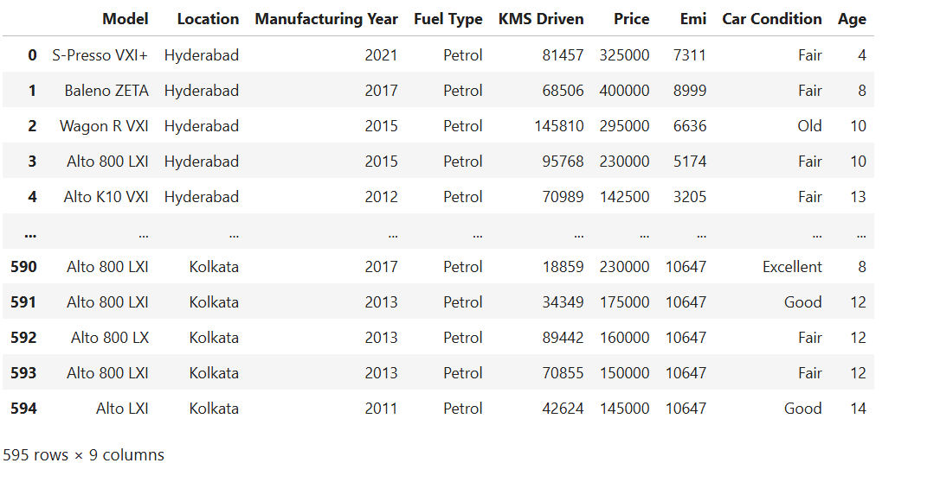
Modify True Value Car Dataset

Slide 6
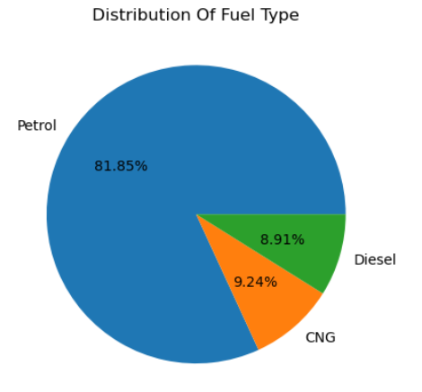
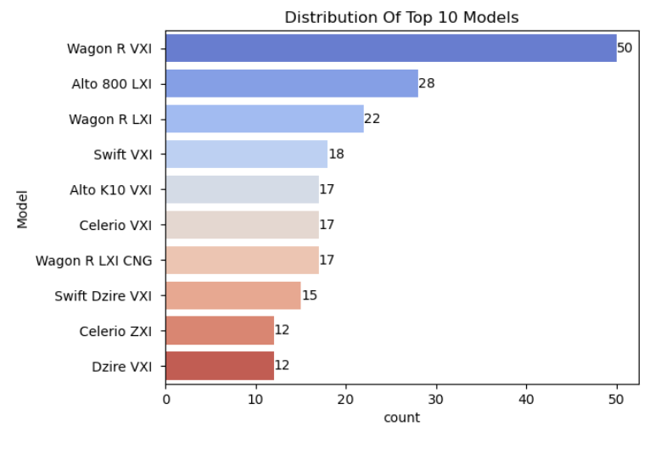
3. Univariate Analysis Steps
Distribution Of Fuel Type
Distribution Of Top 10 Models
The highest used Fuel is Petrol and least is Diesel & CNG
Wagon R VXI is the Most frequnt Model seen in the sale

Slide 7
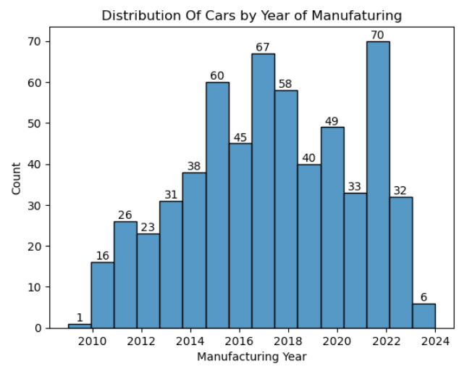
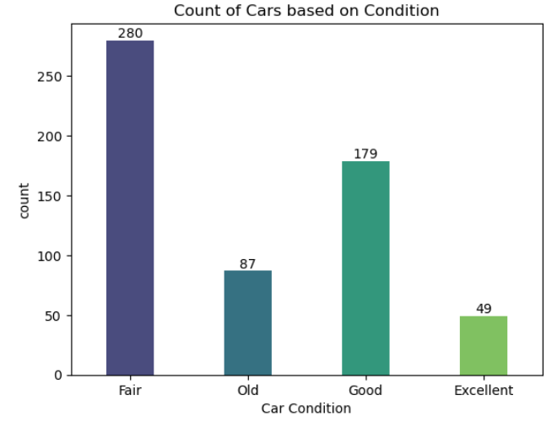
Distribution Of Cars by Year of Manufaturing
Count of Cars based on Condition
The highest Manufacturing Cars in the Year of 2022, 2017, 2015, 2018 and least in the Years 2009, 2024, 2011,
Most Cars are in Fare Condition

Slide 8
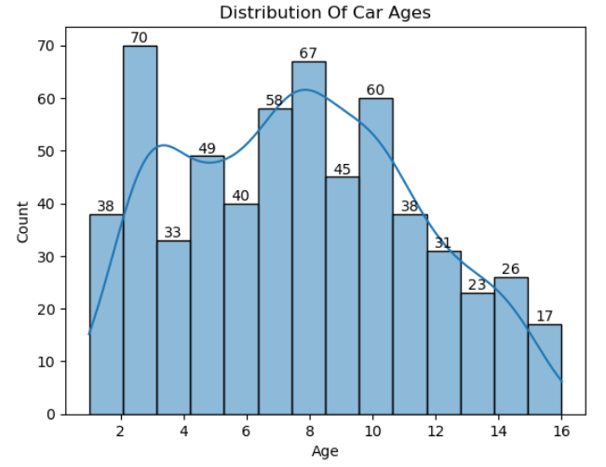
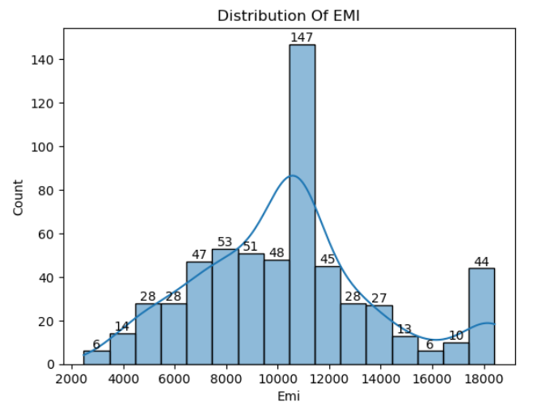
Distribution Of Car Ages
Distribution Of EMI
Most car Ages are 3, 8, 10 Years
Most of The EMI Ranges in between 10000 And 12000

Slide 9
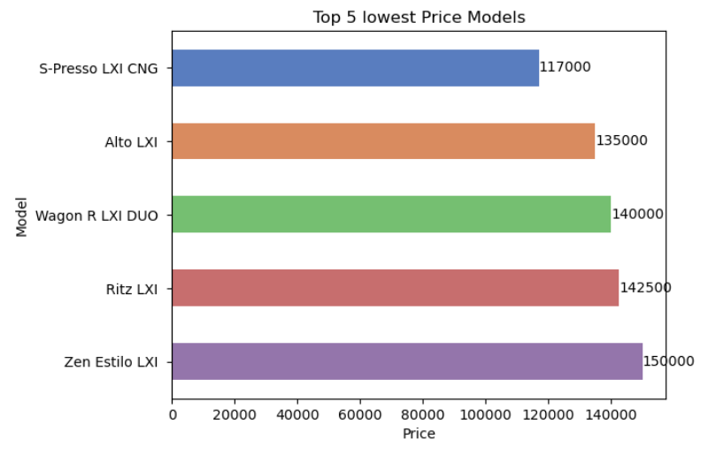
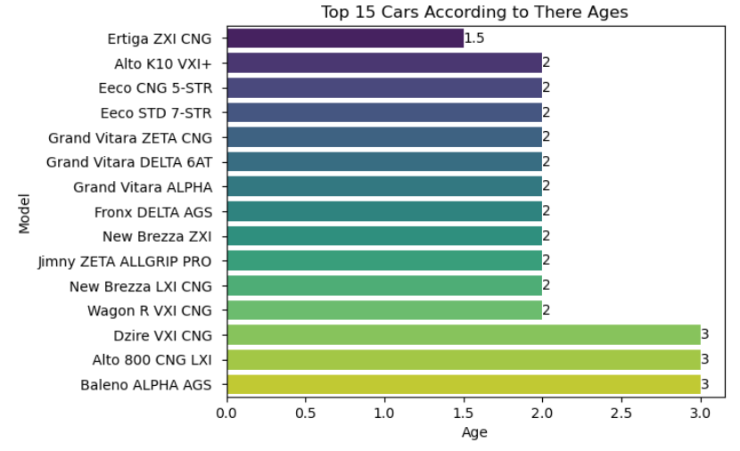
4. Bivariate Analysis Steps
Top 5 lowest Price Models
Top 15 Cars According to There Ages
(Ertiga ZXI CNG, Alto K10 VXI+, Eeco CNG 5-STR, Eeco STD 7-STR) This Cars are Best according to their ages
This Cars are best According to Low Prices

Slide 10
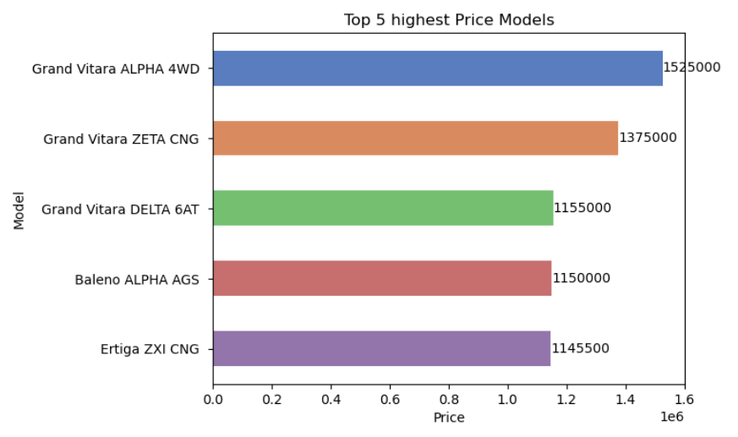
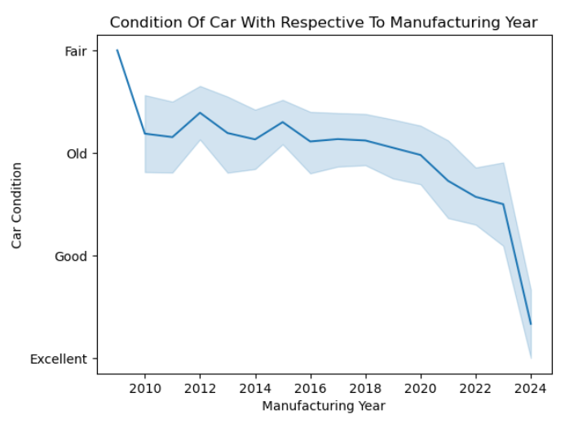
Top 5 highest Price Models
Condition Of Car With Respective To Manufacturing Year
This Cars are Most Expensive
The best car condition between 2022 and 2024

Slide 11
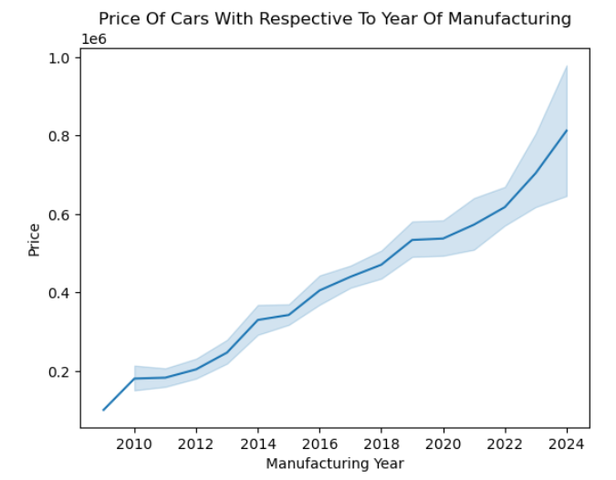
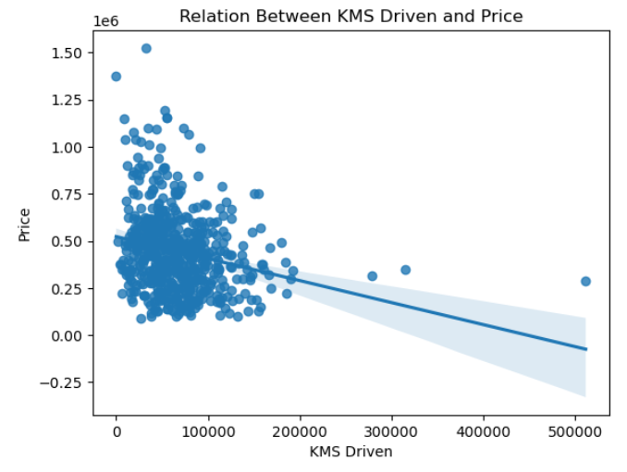
Price Of Cars With Respective To Year Of Manufacturing
Relation Between KMS Driven and Price
AS kms Driven increases, Price decreases and the most cars are between 0 to 150,000km and 2 t0 10 lakhs.
Cars manufactured in 2010 have the lowest prices, while those from 2024 have the highest

Slide 12
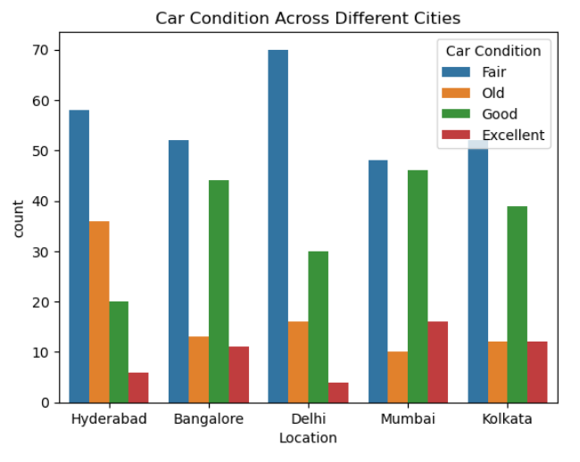
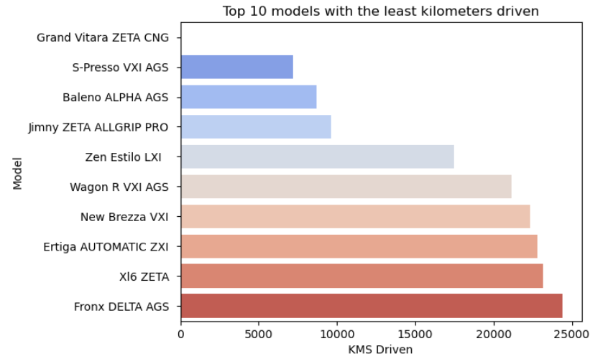
Car Condition Across Different Cities
Top 10 models with the least kilometers driven
This Car Models with the lowest Kilometers Traveled
Cars in Mumbai are in the best condition

Slide 13
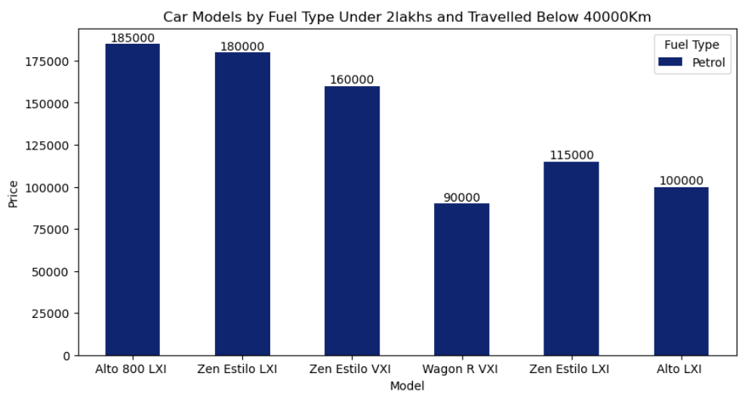
5. Multivariate Analysis Step
Car Models by Fuel Type Under 2lakhs and Travelled Below 40000Km
Most low-priced cars under ₹2 lakh with less than 40,000 km driven are petrol models, where Alto and Zen Estilo variants show better resale value compared to others

Slide 14
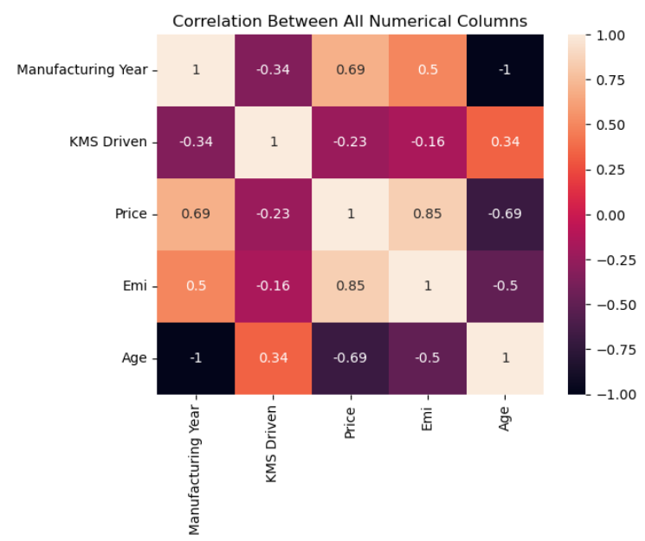
Correlation Between All Numerical Columns

Slide 15
Summary
Data Collected from Maruti True Value (595×8).
Cleaned Data – removed symbols, filled missing values.
Manipulated Data – fixed outliers, added Car Condition & Age.
Univariate – most cars are Petrol, Wagon R VXI common, EMI ₹10k–₹12k.
Bivariate – higher KMs → lower price; Mumbai cars in better condition.
Multivariate – low-price cars (<₹2L, <40k km) mostly Petrol; correlations studied.

Slide 16

THANK YOU

